Slide 1

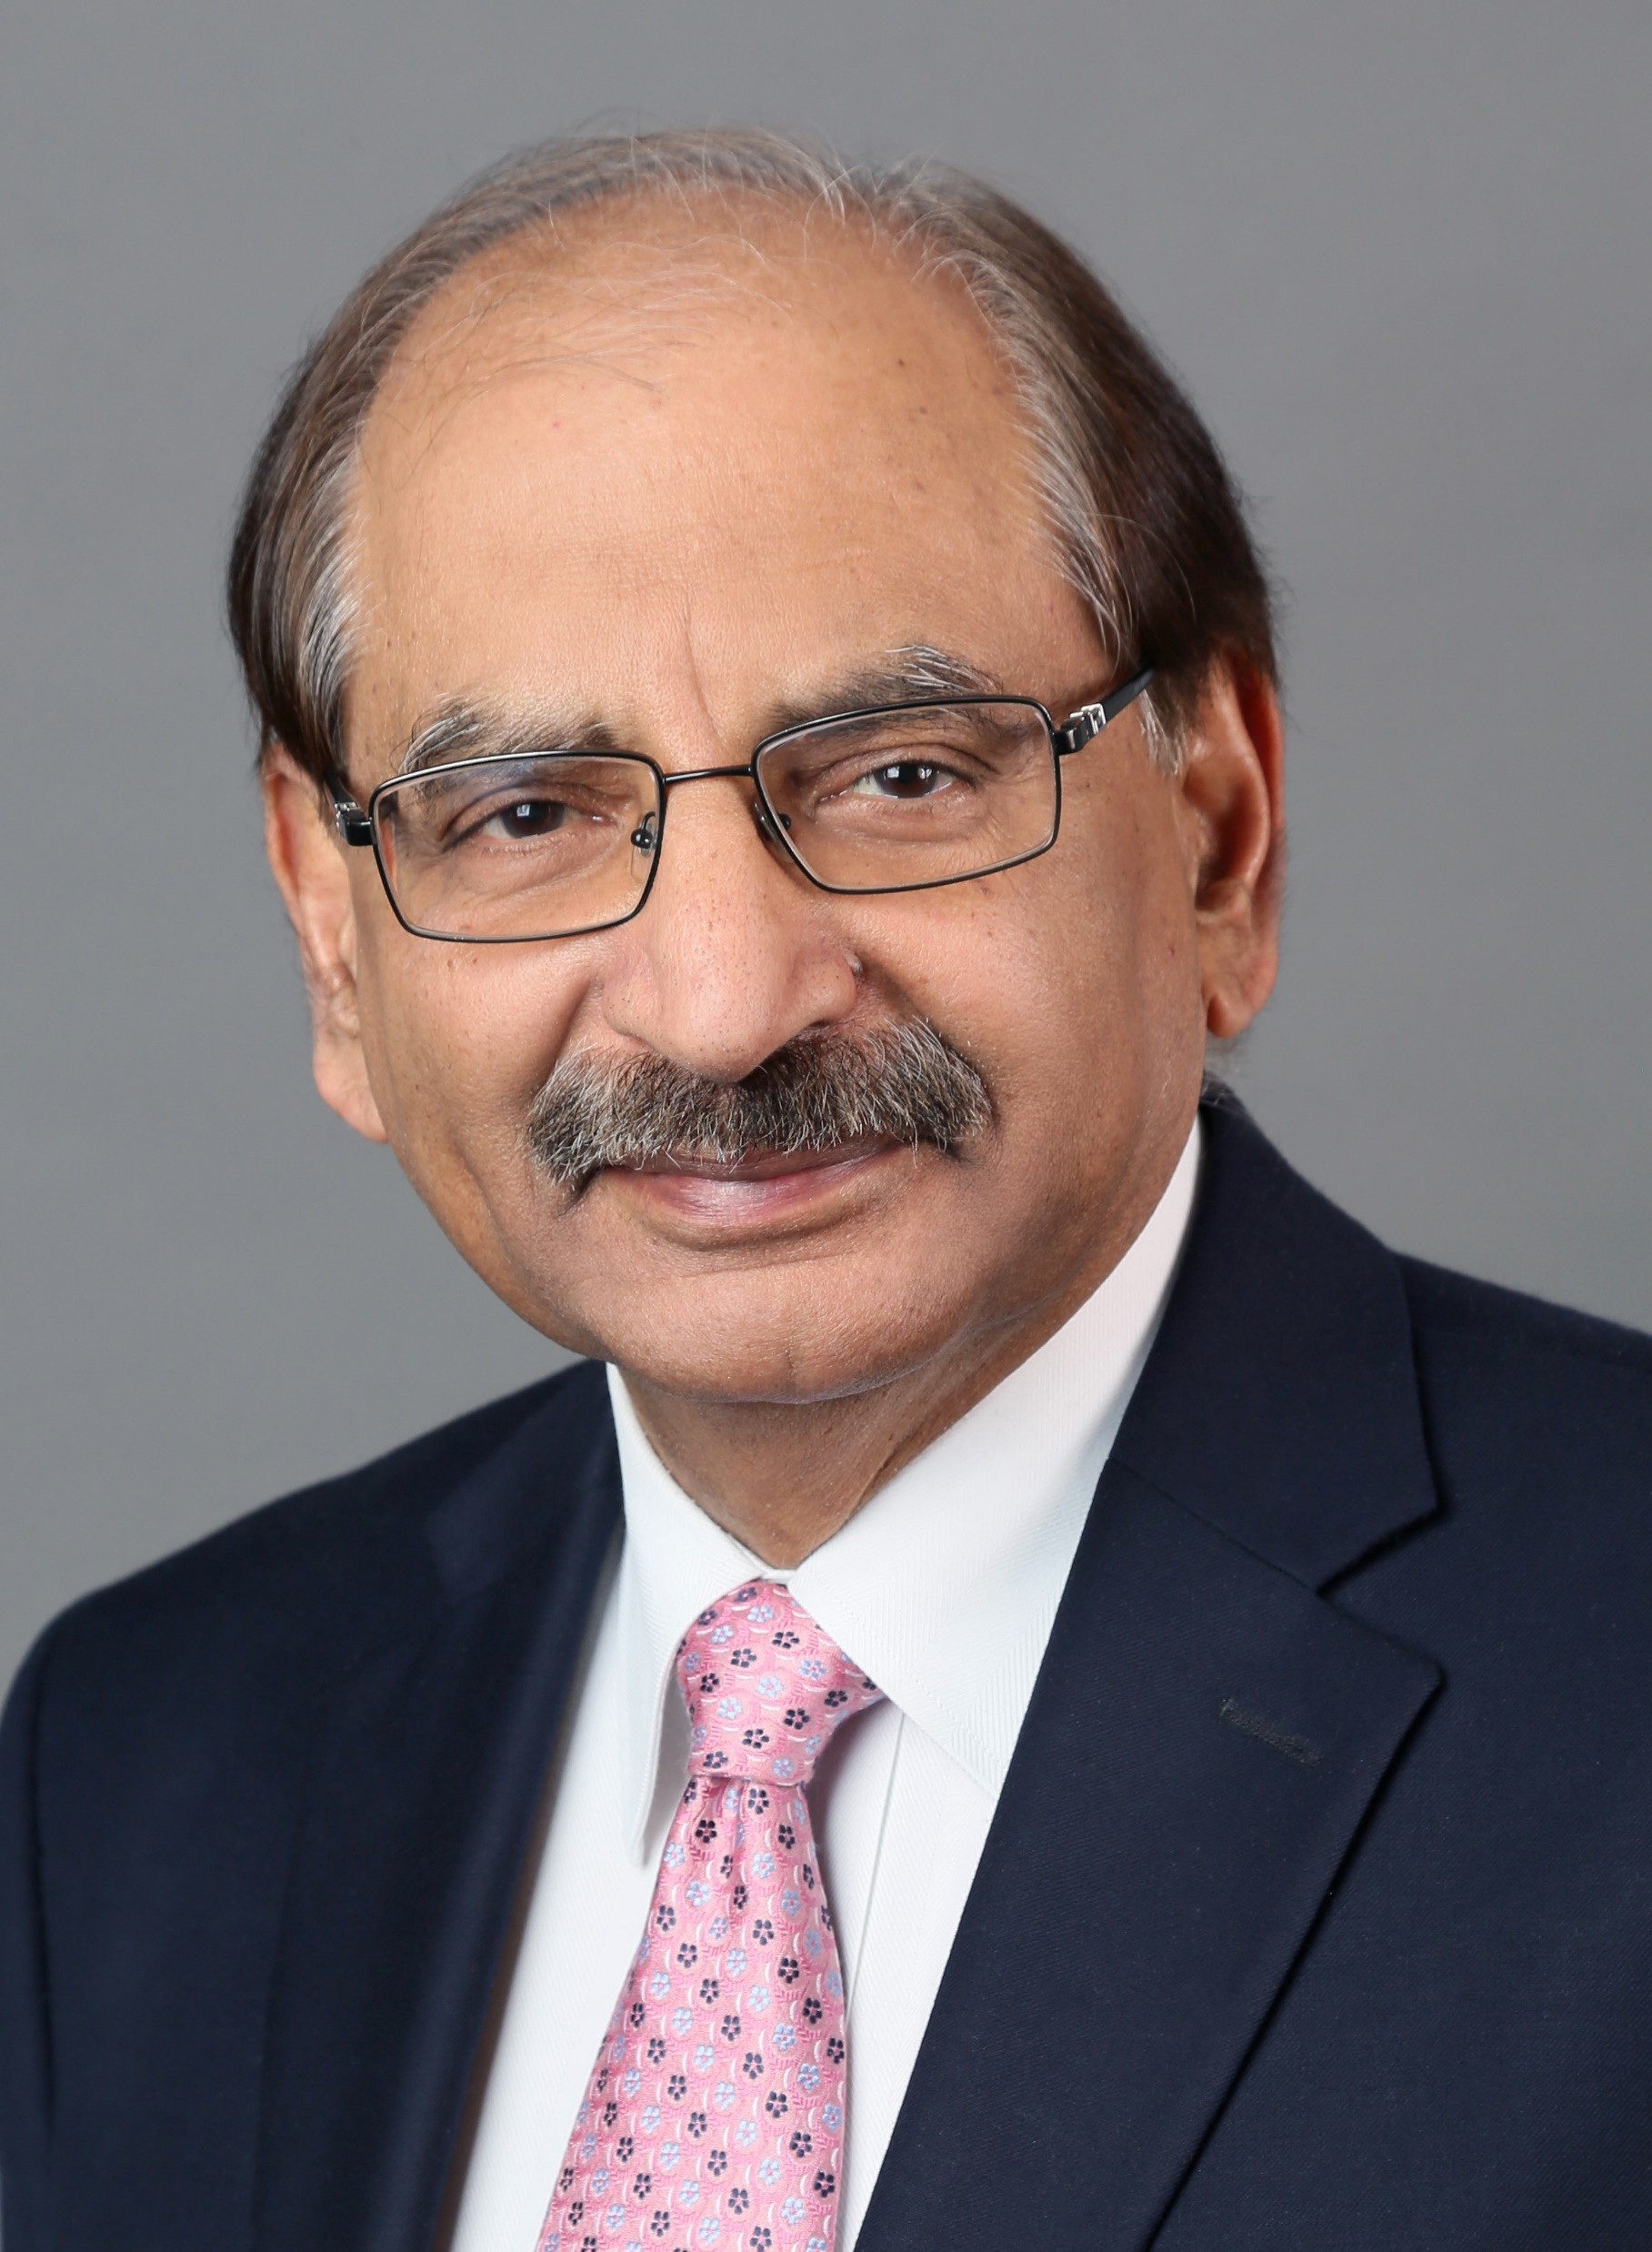
Distinguished Webinar Series in Earthquake Engineering and Seismology
Organized by the Canadian Association of Earthquake Engineering
Building earthquake resistance and resilience in concrete structures with Fibre Reinforced Polymers
Wednesday, June 8, 2022, 3:00 p.m. EDT
Registration Link: https://yorku.zoom.us/meeting/register/tJIrdOyvqTIiH90jWpAzeO7L5wKuMraJZWL3
Abstract
The total annual cost of corrosion is estimated at about 3% of the world’s GDP. To address this, the Civil engineering community over the last thirty years, has been working on efforts to substitute steel with fibre reinforced polymers, FRP, in concrete structures both as internal reinforcement as well as for external retrofitting. This presentation will focus on upgrade of concrete structures especially columns for seismic resistance. Results from the tests on full-scale and large-scale structural components will be presented along with the analytical and design procedures developed as part of this research. The procedure for seismic upgrade for confinement with FRP in the Canadian Codes, CSA S806 and CSA S9 will also be discussed. A brief discussion on the seismic resistance of columns with internal GFRP reinforcement will also be included.
Short Bio: Dr. Sheikh is a Professor in Civil and Mineral Engineering at the University of Toronto and a Fellow of the Canadian Academy of Engineering. His research work on earthquake design, sustainability and resilience of concrete structures has been extensively published and cited as well as used in the field including several design codes around the world. His work has also been featured in various TV programs and print media as an innovative economical solution for some of the deteriorating infrastructure. He is an active member of several national and international committees related to concrete structures and Fibre Reinforced Polymers. Currently, he chairs the CSA subcommittee on Structures with FRP for the Canadian Highway Bridge Design Code.
Dr. Sheikh has received several awards and accolades for his accomplishments including the ACI Structural Research Award for “outstanding contributions to the application of structural engineering research and for notable achievement in research in structural engineering”, and the Canadian Society of Civil Engineering Horst Leipholz Medal for “outstanding contributions to engineering mechanics and research”.
Dr. Shamim Sheikh, PEng, FCAE
Professor,
Department of Civil and Mineral Engineering
Univ. of Toronto
Shamim.sheikh@utoronto.ca

